Slide 1
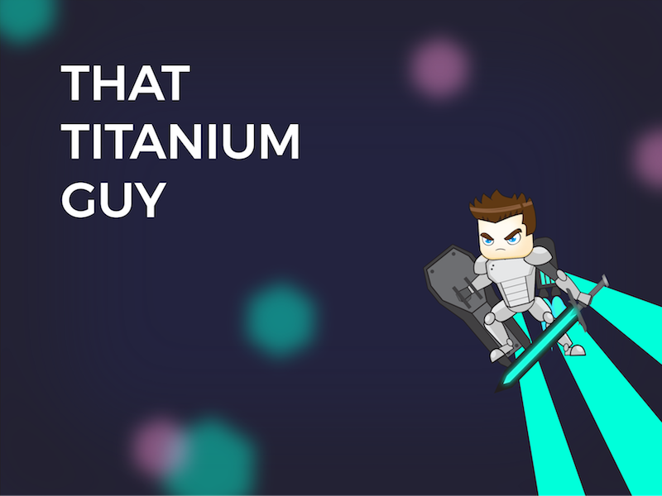
The Good, The Bad, and The Ugly

Slide 2
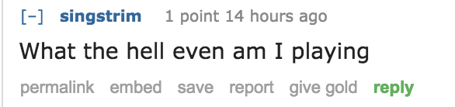

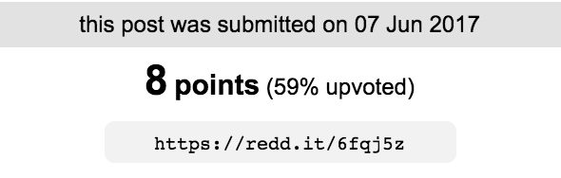
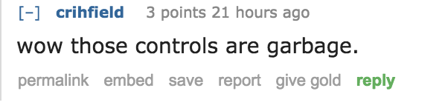
The bad: Reddit hates us

Slide 3
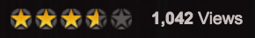
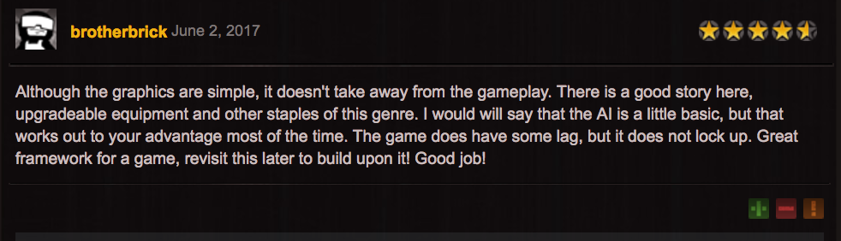
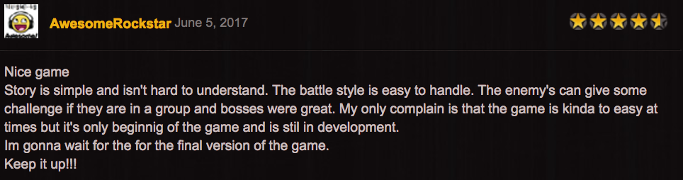
The good: other people are decent

Slide 4
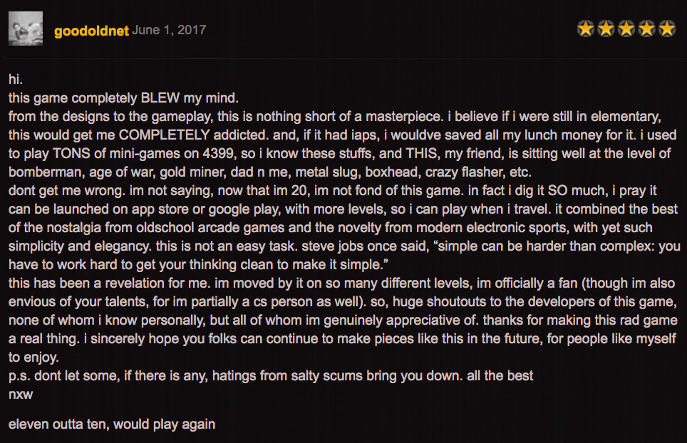
Especially this guy

Slide 5
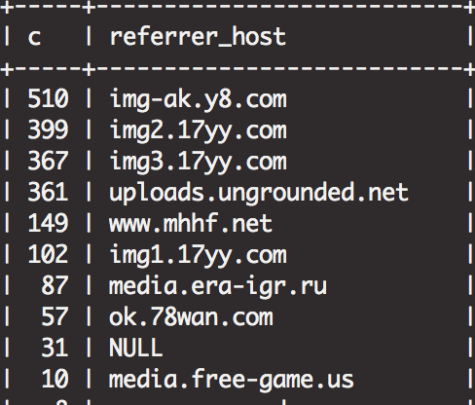
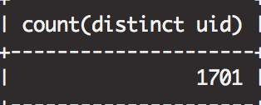
Got put up to some random sites

Slide 6
The Ugly: Past - Present Releases

Slide 7
First Release

Slide 8
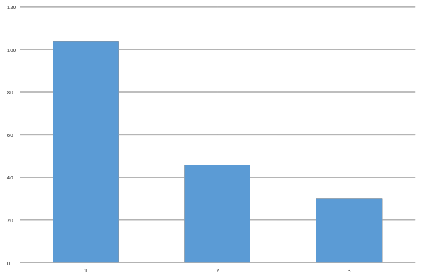
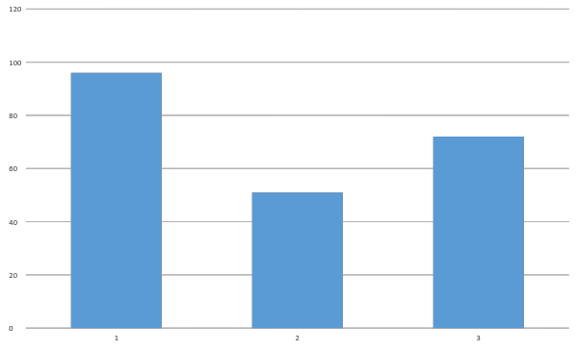
Distinct players at each level Level complete instances per level
Level | # of completes
1 | 96
2 | 51
3 | 72

Slide 9
Second Release

Slide 10
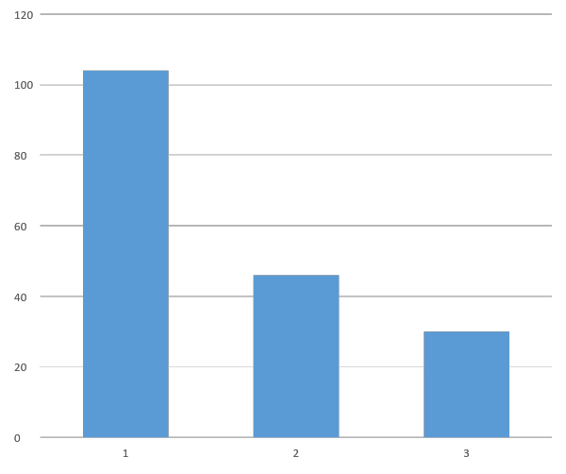
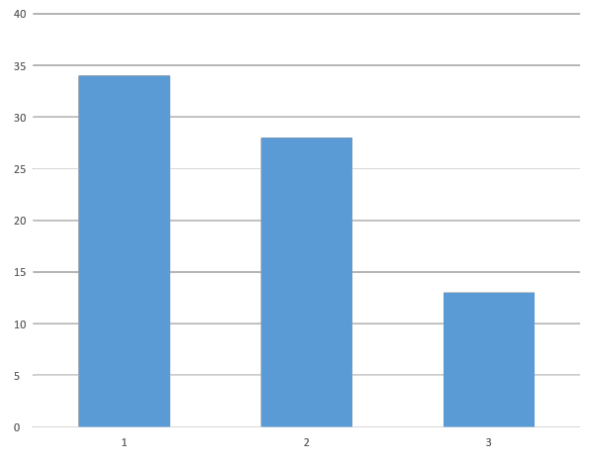
Distinct players at each level
First release
Second release

Slide 11
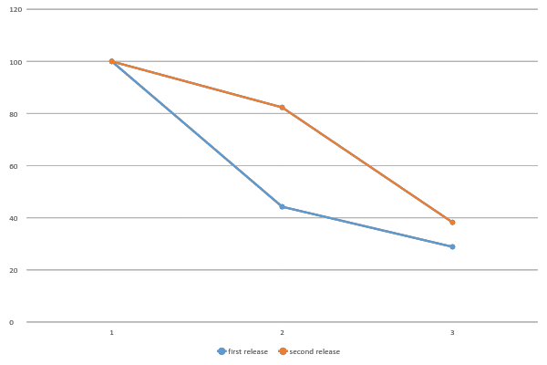
Percentage of players at each level
first release | second release
100 | 100
44.23 | 82.35
28.85 | 38.24

Slide 12
Third & Forth Release

Slide 13
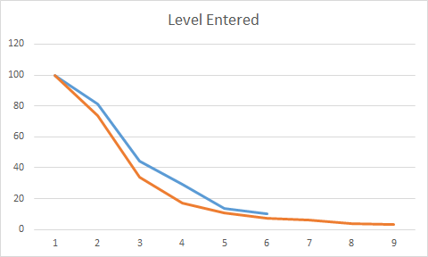
Blue: Release 3
Orange: Release 4

Slide 14
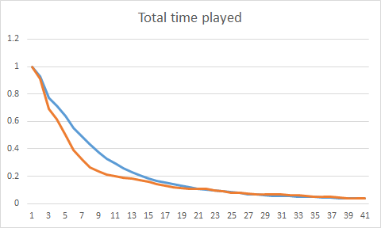
Blue: Release 3
Orange: Release 4

Slide 15
Avg. Play time
Release 3: 13.9 min
Release 4: 9.7 min

Slide 16
Return Rate
Third release:
More than once: 6.35%
Twice: 1.6%
Three times: 0.77%
Fourth release:
More than once: 2.9%
Twice: 0.79%
Three times: 0.52%

Slide 17
BOSS FARMS
Release 3:
Boss1: 2278 : 754
Boss2: 1089 : 176
Release 4:
Boss1: 331 : 135
Boss2: 197 : 32
Final Boss: 71 : 12

Slide 18
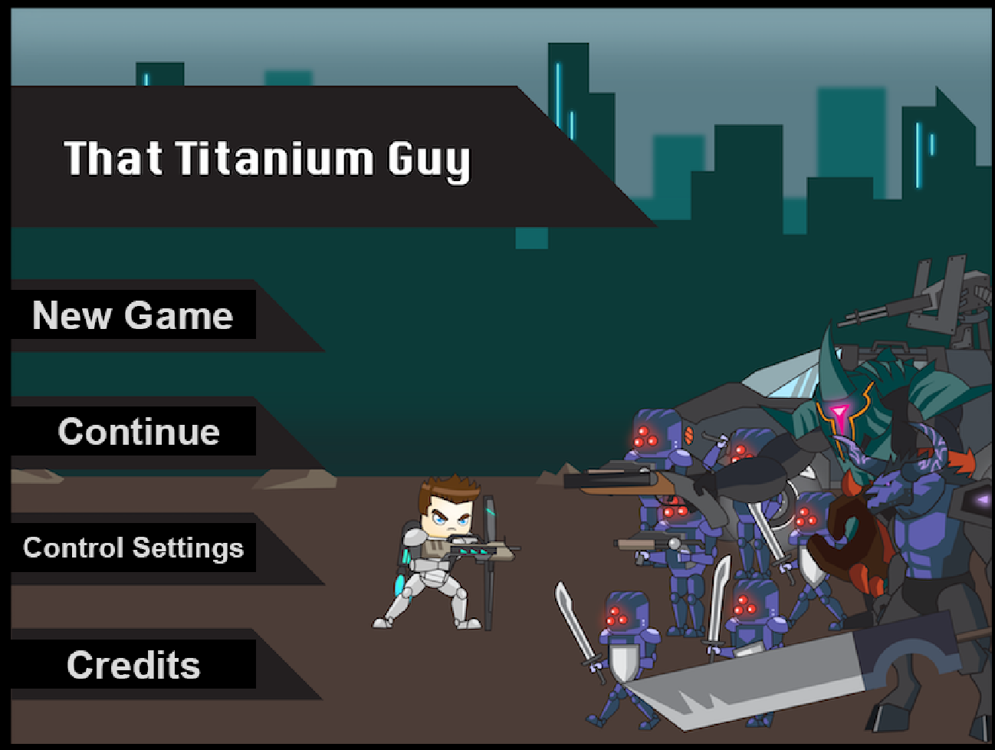

Slide 19
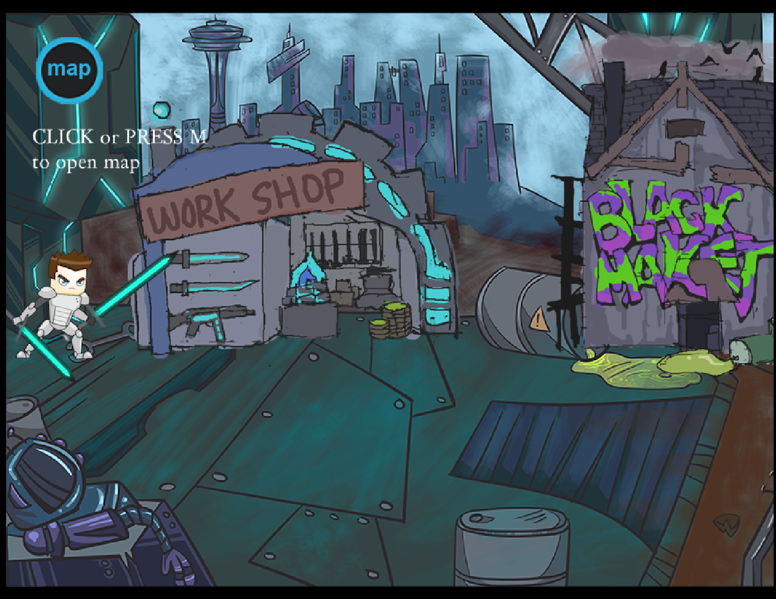

Slide 20
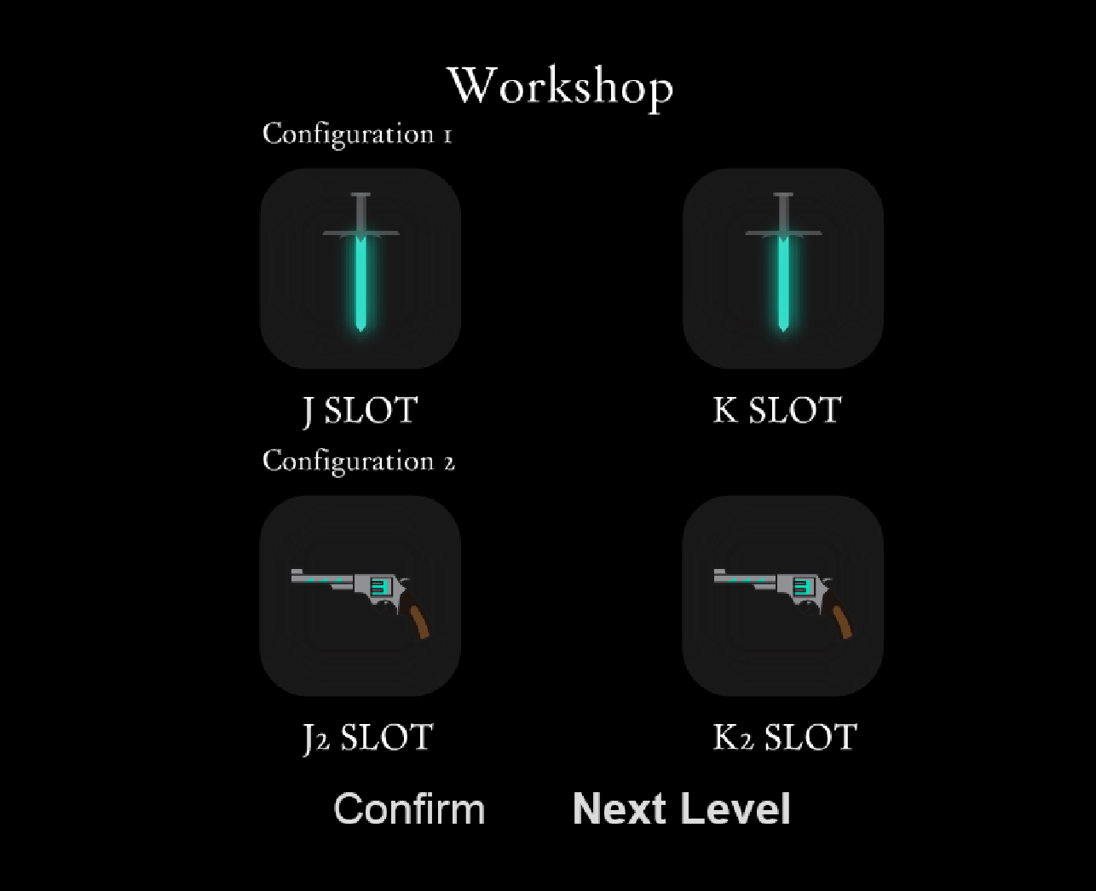

Slide 21
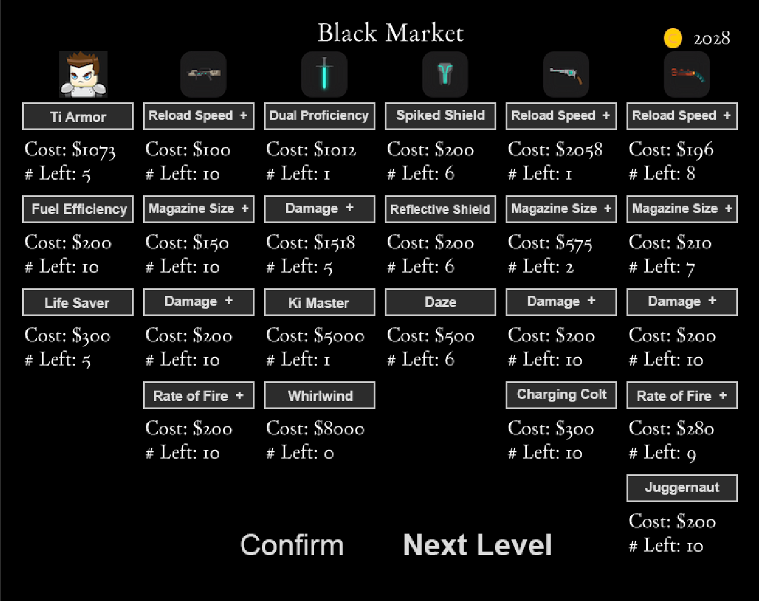

Slide 22
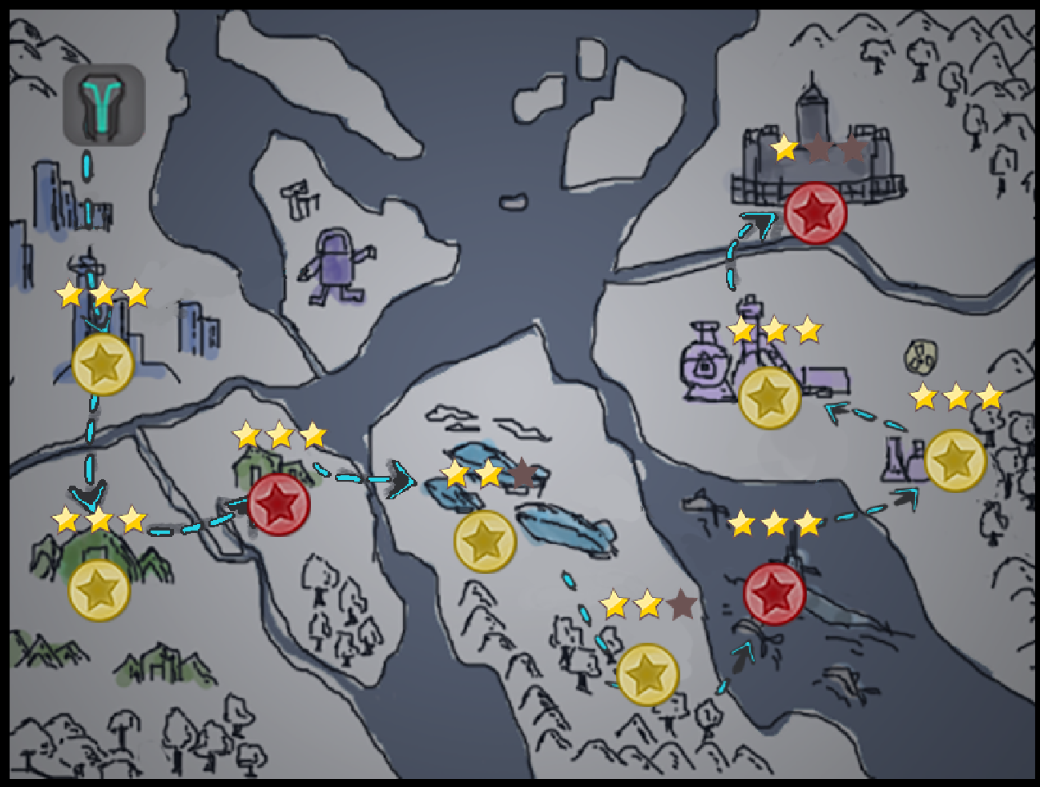

Slide 23
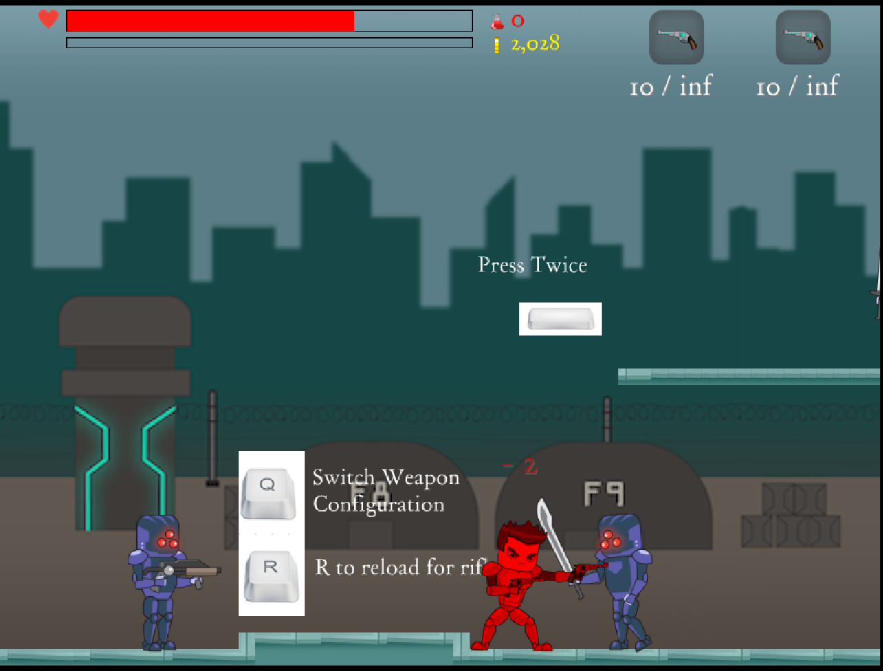
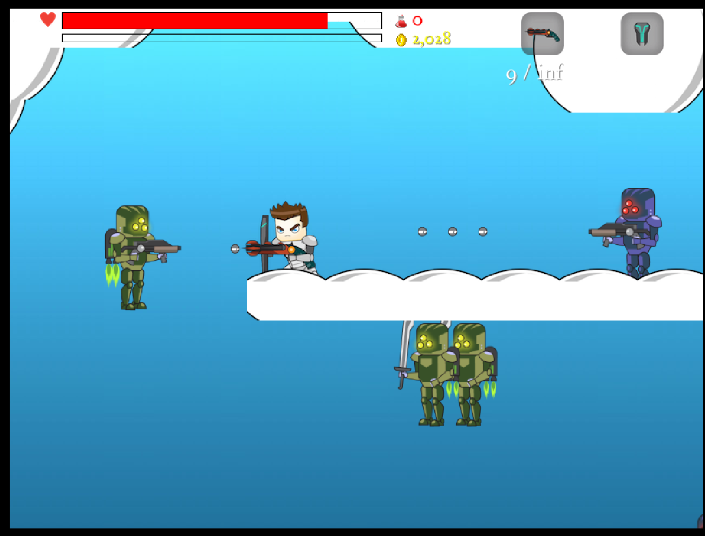

Slide 24
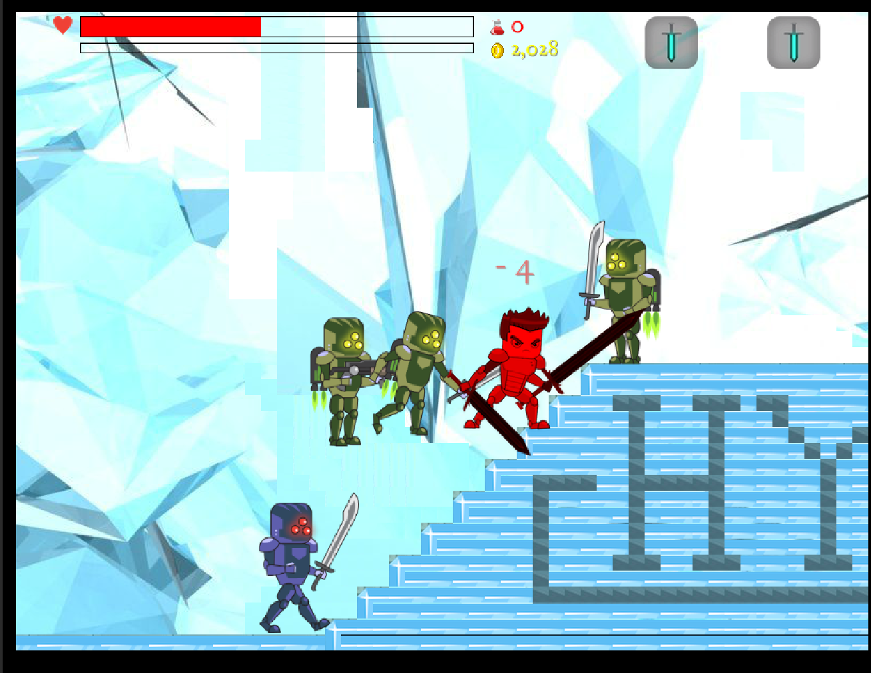
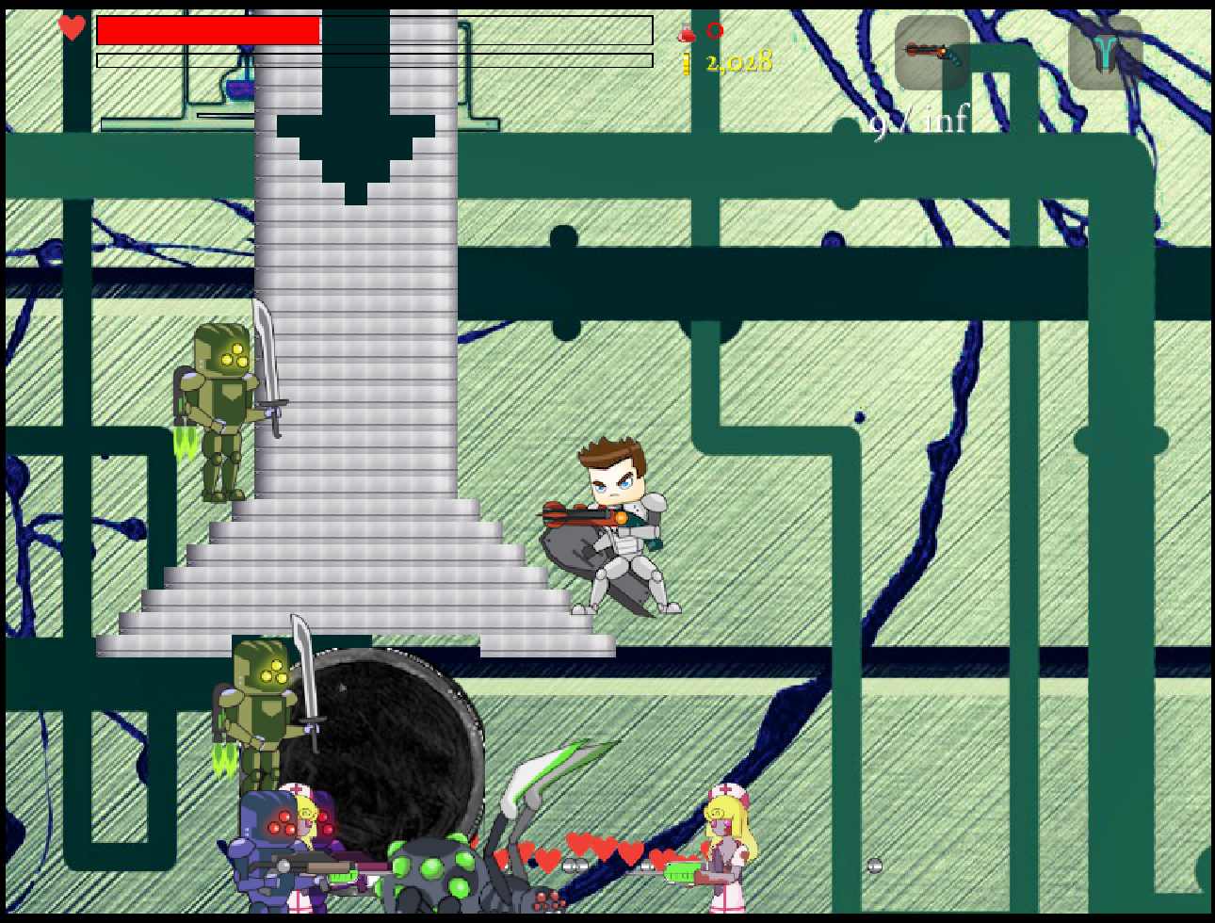

Slide 25
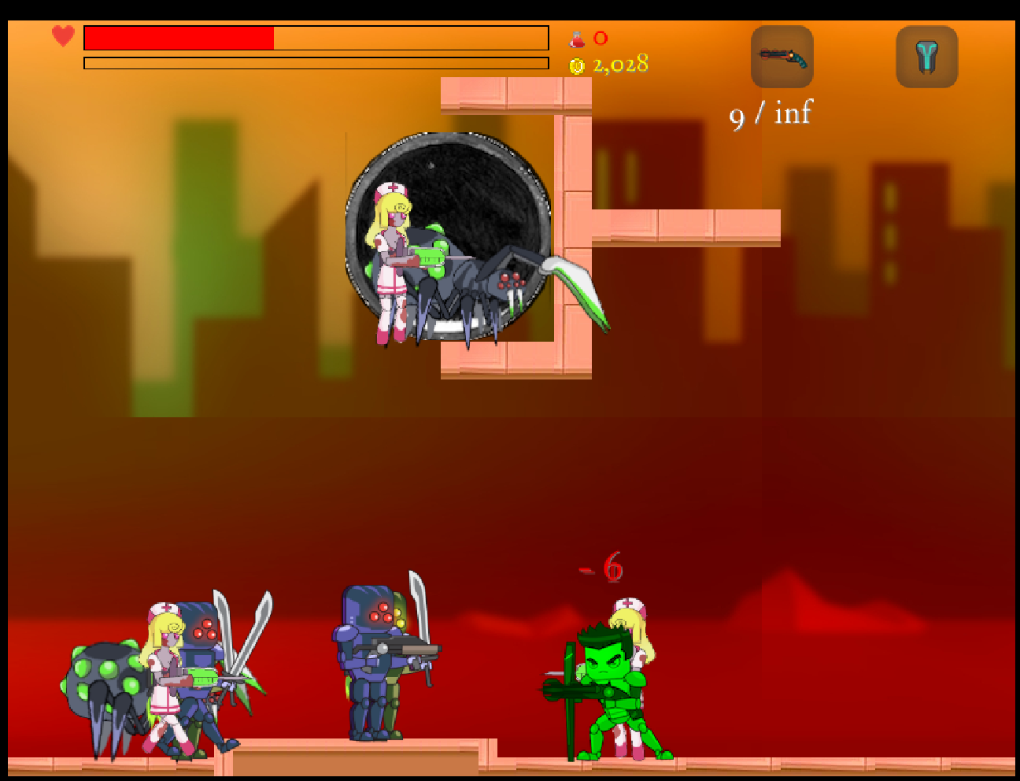

Slide 26
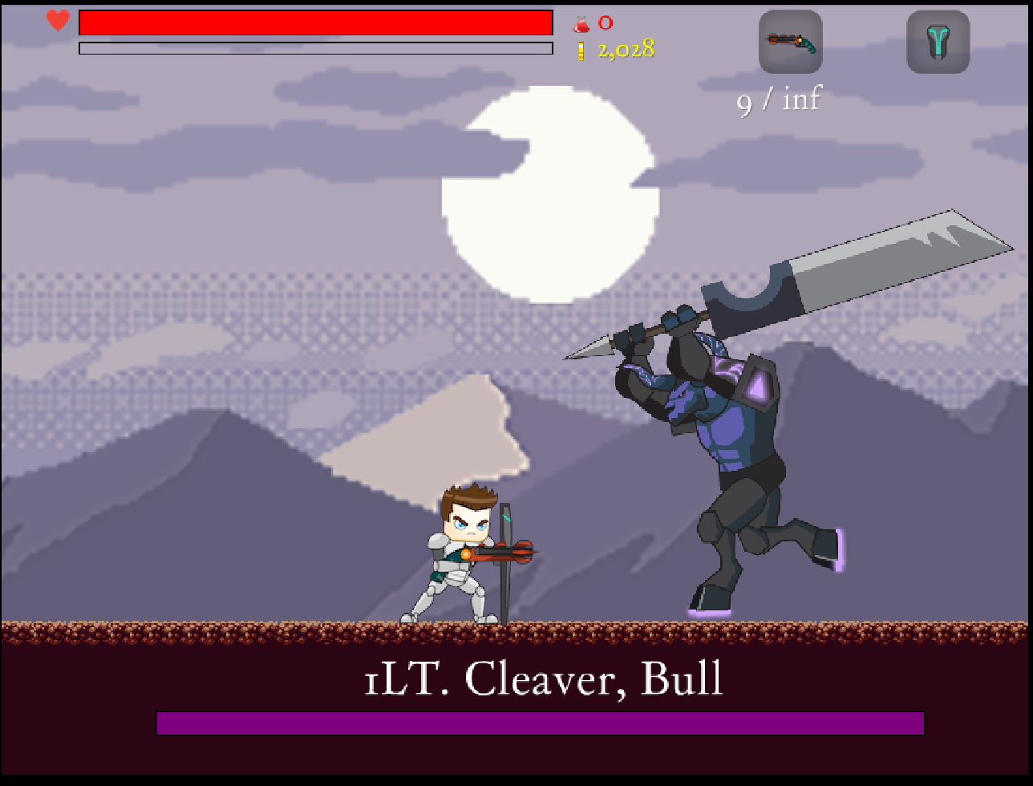

Slide 27
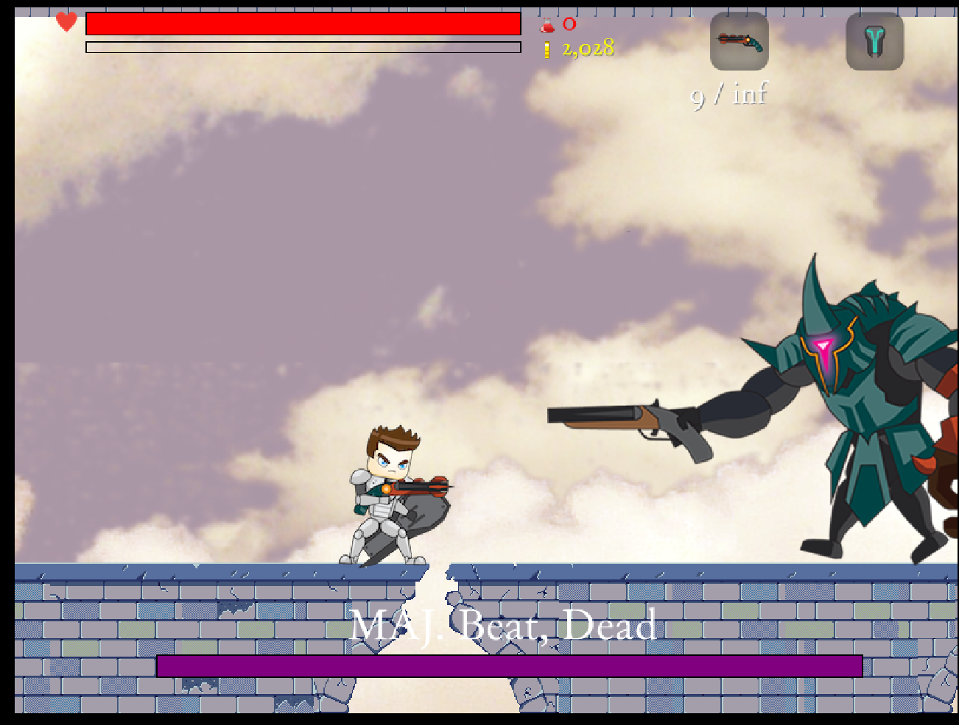

Slide 28
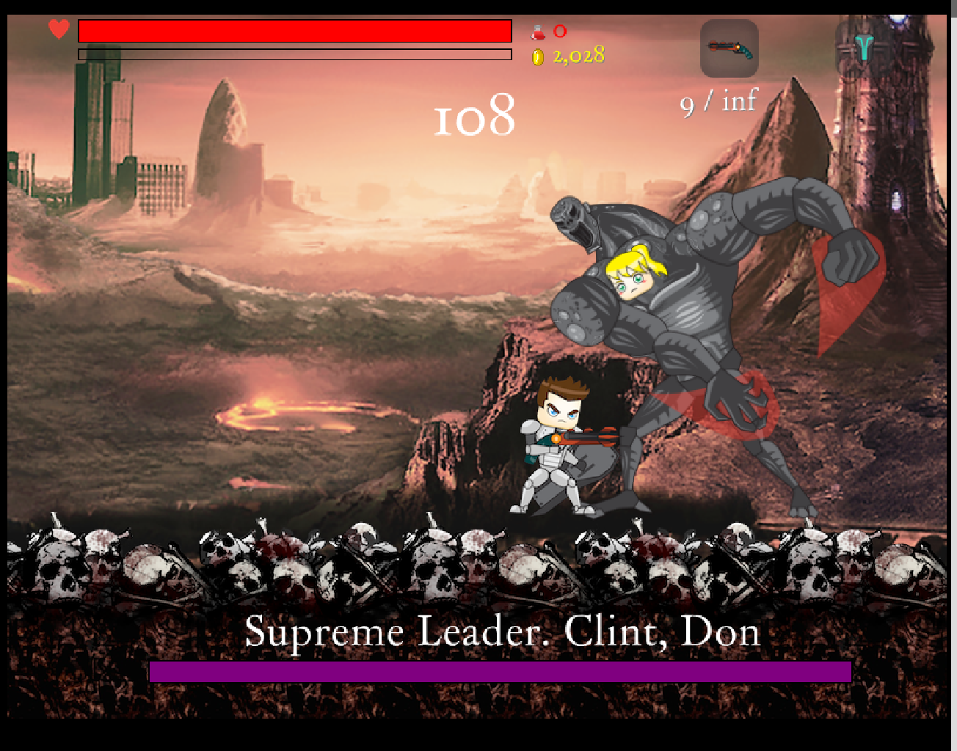

Slide 29


